Slide 1
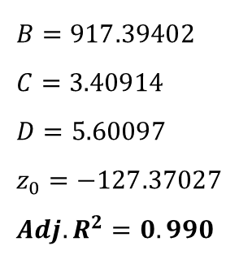

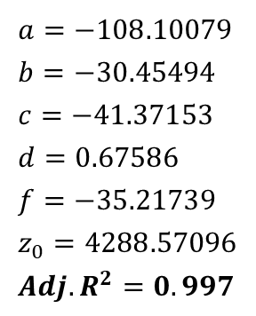

Blind test: 역산
$$UV=Bexp\left(−\frac{x}{C}−\frac{y}{D}\right)+z_{0}$$
$$IR=ax+by+{cx}^{2}+{dy}^{2}+fxy+z_{1}$$
$$B=917.39402 \\ C=3.40914 \\ D=5.60097 \\ z_{0}=−127.37027 \\ {Adj. R}^{2}=0.990$$
$$a=−108.10079 \\ b=−30.45494 \\ c=−41.37153 \\ d=0.67586 \\ f=−35.21739 \\ z_{0}=4288.57096 \\ {Adj. R}^{2}=0.997$$
UV: UV photodiode 출력값 (V)
IR: IR photodiode 출력값 (V)
x: NH₄OH 농도 (%)
y: H₂O₂ 농도 (%)

Slide 2





Blind test: 역산
$$UV=Bexp\left(−\frac{x}{C}−\frac{y}{D}\right)+z_{0}$$
$$\frac{UV−z_{0}}{B}=exp\left(−\frac{x}{C}−\frac{y}{D}\right)$$
$$\ln{\frac{UV−z_{0}}{B}}=−\frac{x}{C}−\frac{y}{D}$$
$$x=−C\ln{\frac{UV−z_{0}}{B}}−\frac{C}{D}y$$
$$t=−C\ln{\frac{UV−z_{0}}{B}}, ∴x=t−\frac{C}{D}y$$

Slide 3

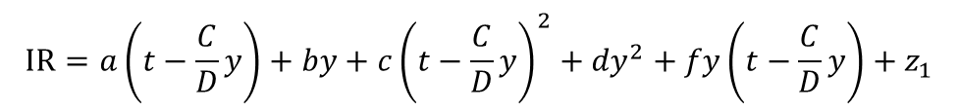
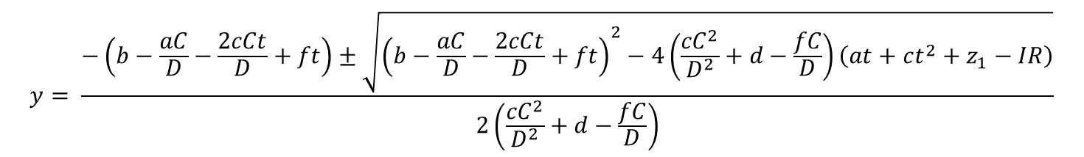



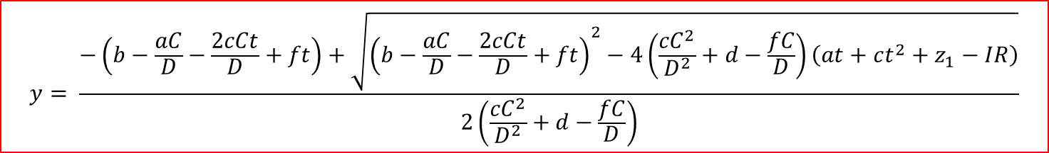
Blind test: 역산
$$x=t−\frac{C}{D}y$$
$$t=−C\ln{\frac{UV−z_{0}}{B}}$$
대입
$$IR=ax+by+{cx}^{2}+{dy}^{2}+fxy+z_{1}$$
$$IR=a\left(t−\frac{C}{D}y\right)+by+c{\left(t−\frac{C}{D}y\right)}^{2}+{dy}^{2}+fy\left(t−\frac{C}{D}y\right)+z_{1}$$
$$at−\frac{aC}{D}y+by+ct^{2}−\frac{2cCt}{D}y+\frac{{cC}^{2}}{D^{2}}y^{2}+{dy}^{2}+fty−\frac{fC}{D}y^{2}+z_{1}−IR=0$$
$$\left(\frac{{cC}^{2}}{D^{2}}+d−\frac{fC}{D}\right)y^{2}+\left(b−\frac{aC}{D}−\frac{2cCt}{D}+ft\right)y+\left(at+ct^{2}++z_{1}−IR\right)=0$$
$$y= \frac{−\left(b−\frac{aC}{D}−\frac{2cCt}{D}+ft\right)±\sqrt{{\left(b−\frac{aC}{D}−\frac{2cCt}{D}+ft\right)}^{2}−4\left(\frac{{cC}^{2}}{D^{2}}+d−\frac{fC}{D}\right)\left(at+ct^{2}+z_{1}−IR\right)}}{2\left(\frac{{cC}^{2}}{D^{2}}+d−\frac{fC}{D}\right)}$$
$$y= \frac{−\left(b−\frac{aC}{D}−\frac{2cCt}{D}+ft\right)+\sqrt{{\left(b−\frac{aC}{D}−\frac{2cCt}{D}+ft\right)}^{2}−4\left(\frac{{cC}^{2}}{D^{2}}+d−\frac{fC}{D}\right)\left(at+ct^{2}+z_{1}−IR\right)}}{2\left(\frac{{cC}^{2}}{D^{2}}+d−\frac{fC}{D}\right)}$$
$$∵y>0$$

